Slide 1
Web Development 3
Lab (Intro)
Ashley Cahill
ashley.cahill@tus.ie

Slide 2
Learning Outcomes
Describe Webservers
Describe XAMPP
Install XAMPP
Install NetBeans

Slide 3
Web Servers
A web server accepts and fulfills requests from clients for static content (i.e., HTML pages, files, images, and videos) from a website.
Web servers handle HTTP requests and responses only.
An application server exposes business logic to the clients, which generates dynamic content. It is a software framework that transforms data to provide the specialized functionality offered by a business, service, or application. (www.educative.io/answers/web-server-vs-application-server)

Slide 4
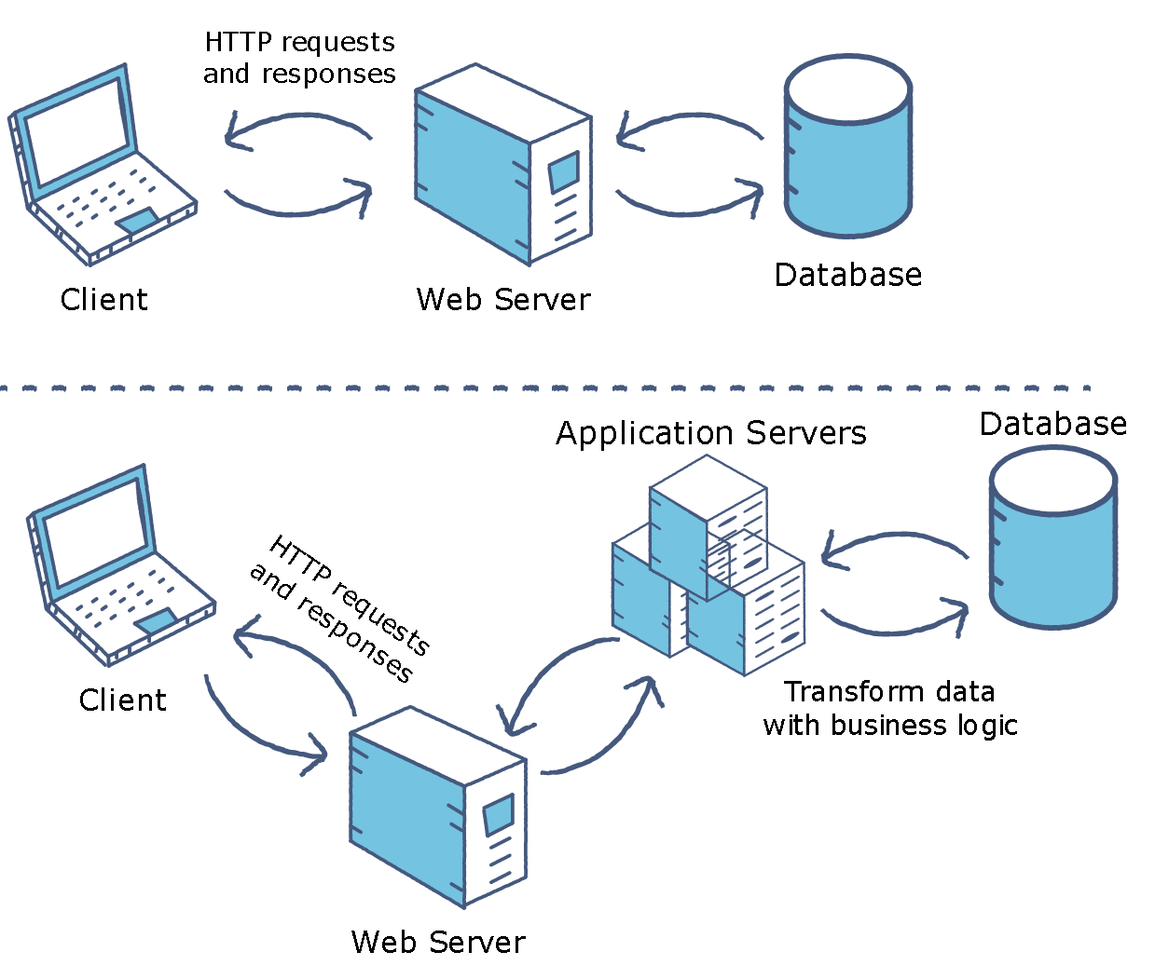
Web Servers vs Application Server

Slide 5
XAMPP
Developed in 2002.
XAMPP is an abbreviation for cross-platform, Apache, MySQL, PHP and Perl.
Free and open-source cross-platform web server solution stack package developed by Apache Friends.

Slide 6
XAMPP Installation
www.apachefriends.org/download.html
Executable installer.
Available for Windows, Linux and OS X download/installation.

Slide 7
NetBeans
NetBeans is an integrated development environment for Java, C++, HTML/JavaScript and PHP.
Free and open source.
Started as a student project at Charles University in Prague in 1996.
1999, bought by Sun Microsystems.
2000, Sun Microsystems acquired by Oracle.
2016, Oracle donated to Apache Software Foundation and rebranded as Apache NetBeans.

Slide 8
NetBeans Installation
https://netbeans.apache.org/download/index.html

